Slide 1
CSE408 TSP
Lecture # 36

Slide 2
Traveling Salesman Problem
For each city i, 1≤ i ≤ n, find the sum si of the distances from city i to the two nearest cities; compute the sums of these n numbers, divide the result by 2, and, if all the distances are integers,round up the result to the nearest integer:

Slide 3

Traveling Salesman Problem

Slide 4
Edge(a,d) and (d,a)

Slide 5
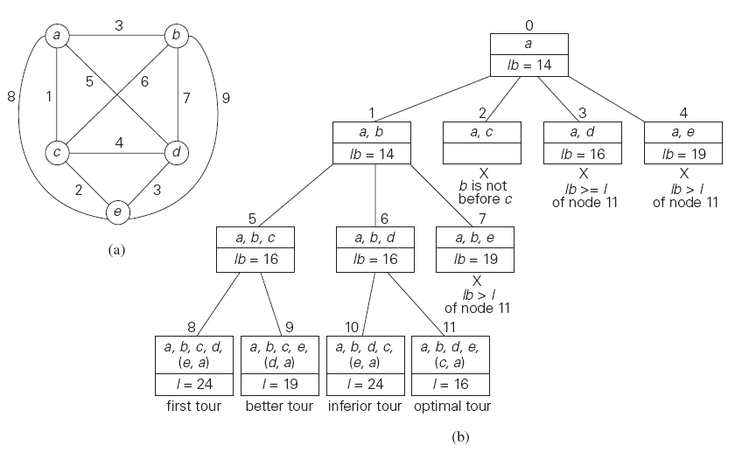
Example

Slide 6
Thank You !!!

